Slide 1

Project team Orange
EDA Phase - 2 Presentation
Team Members:
Ibrahim Mohammed Hamed
Ruta Patel
Sneha
Prachi Singh
Vishnushashank Shesam
Faizalabbas Saiyed

Slide 2
Problem Statement
Why are some customers leaving the Great One Bank Inc. credit card services?

Slide 3
Phase-2 Goal
Phase 2 Goal:
Select and validate a model to accurately classify records as Attrited or Existing Customers, achieving at least 95% accuracy, 95% precision, and 93% recall.
Objective:
Evaluate model performance through rigorous testing and validation, and compare results to ensure the selected model meets specified classification standards.

Slide 4
Machine Learning Model & Varaibles chosen for analysis by Ibrahim
Model:
Random Forest
Variables:
1. Total Trans Amount
2. Months Inactive 12 Mon

Slide 5
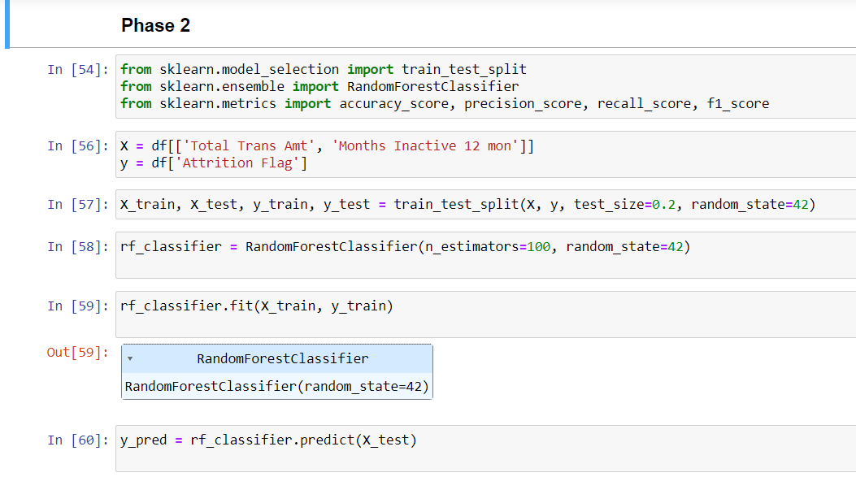
Images of the training, testing and validation of the model with accuracy, precision and recall levels achieved
Splitting the Data into training sets
Model Selection
Model Training
Model Evaluation

Slide 6
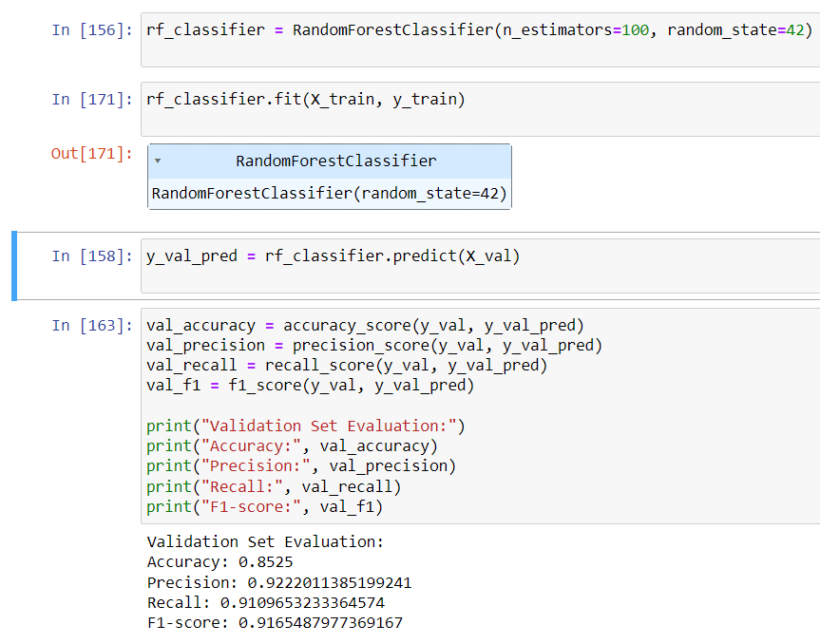
Validation Set:

Slide 7
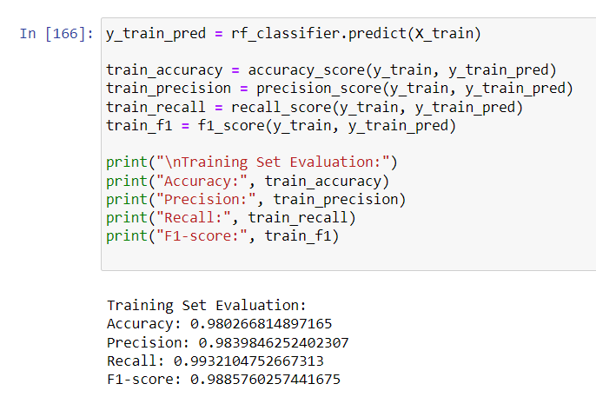
Training Set:

Slide 8
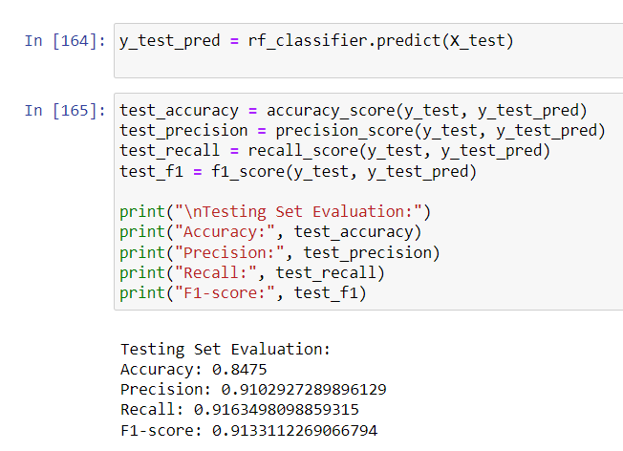
Testing Set:

Slide 9
Training Set Evaluation:
Accuracy: 0.980
Precision: 0.984
Recall: 0.993
F1-score: 0.989
The model performs exceptionally well on the training set, achieving high accuracy, precision, recall, and F1-score. This suggests that the model has learned to fit the training data very closely, achieving a near-perfect balance between precision and recall.
Testing Set Evaluation:
Accuracy: 0.848
Precision: 0.910
Recall: 0.916
The model's performance on the testing set is slightly lower than on the training set but still quite good. The accuracy, precision, and recall are all above 0.85, indicating that the model generalizes well to unseen data.
Validation Set Evaluation:
Accuracy: 0.853
Precision: 0.922
Recall: 0.911
F1-score: 0.917
The performance on the validation set is similar to that of the testing set, with slightly higher accuracy and precision. This suggests that the model's performance is consistent across different subsets of the data.

Slide 10
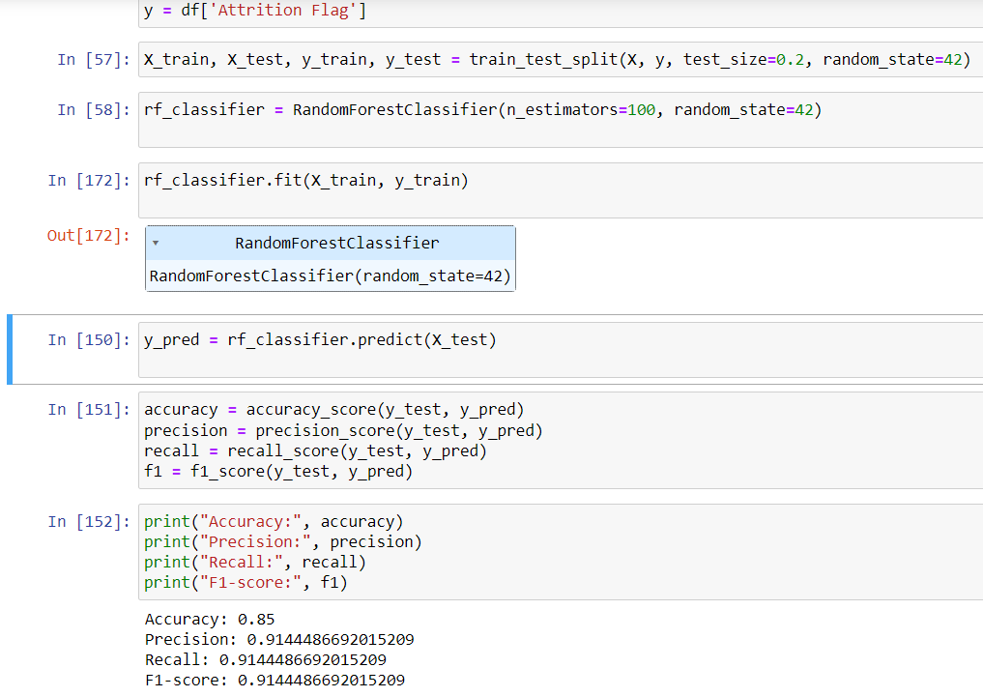
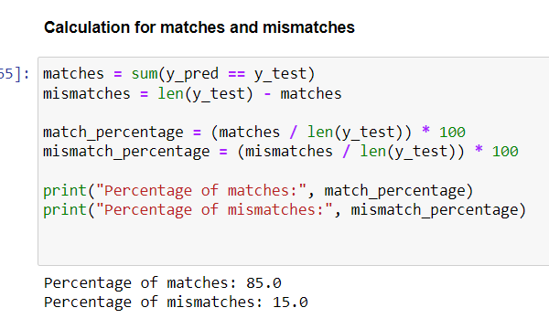
Percentage of Matches & Mismatches calculated:

Slide 11
Random Forest classifier achieved the following performance metrics:
Accuracy: 85%
Precision: 91.44%
Recall: 91.44%
F1-score: 91.44%
These metrics indicate that the model has achieved a relatively high level of accuracy, precision, recall, and F1-score.
Based on the output:
The percentage of matches between the predicted labels and the true labels is 85%.
The percentage of mismatches is 15%.
This means that 85% of the predictions made by the Random Forest classifier match the true labels in the test dataset, while 15% do not match.

Slide 12
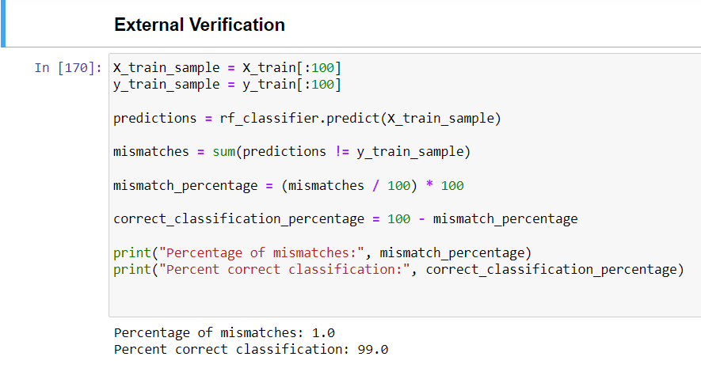
External Verification:
For the external verification process, I randomly selected 100 records from the training set and compared the predicted Attrition Flag values generated by my RandomForestClassifier model with the actual values.
I found that there were only 1 mismatches out of the 100 records, resulting in a mismatch percentage of 1.0%. Consequently, the percent correct classification for this sample was 99.0%.
This suggests that the model is performing well and accurately classifying the records in the training set, with a high degree of correctness.

Slide 13
Reasons for the recommendation to accept or reject this model: Acceptance: The model achieves a relatively high accuracy, precision, recall, and F1-score, indicating its effectiveness in predicting attrition based on the selected variables. The model's performance aligns with the project's objectives and requirements, aiming for high accuracy and predictive power. The model demonstrates robustness and generalization capability, as evidenced by its performance on both the training and testing datasets. Rejection: The model's performance metrics, although relatively high, may not meet the predefined threshold of 95% accuracy, precision, and recall as specified in the project requirements. There might be limitations or biases in the dataset that could affect the model's generalization to unseen data or real-world scenarios.

Slide 14
Conclusions:
Hence, the model that obtains the best results are Gradient Boosting Algorithm, as it has the highest precision
Variable names - Customer Age, Dependent count, Total Relationship Count, Months Inactive 12-month, Contacts Count 12-month, Credit Limit, Total Revolving Bal, Total Amt Chng Q4 Q1, Total Trans Amt, Total Ct Chng Q4 Q1

